Slide 1
Design, modeling and control of bipedal laminate robot
Taha Shafa
Advisor: Daniel Aukes

Slide 2
Outline

Slide 3
Problem Statement
Laminate robotics contain many advantages in the cost and ease of manufacturability, however they are difficult to model and control
Currently there are not used for high precision applications
I want to show that a laminate robot can be designed, modeled, and controlled in such a way that will eventually allow for high precision applications with laminate robotics

Slide 4
Challenges
Keeping costs down means cheap motors
Cheap motors have less desirable properties
Their behavior is harder to model/predict/control
High torque motors are needed for controls applications
High torque motors are heavier
Difficult to support weight of heavy motors with laminate materials
Flexible materials are difficult to model
Flexible materials are more prone to degradation
Their models will be completely changed if there are any unwanted bends or tears

Slide 5
Background
What are laminate robots?
Why do we want to develop them?
What are the advantages and disadvantages of control algorithms?
Why are there not more control engineers implementing their knowledge onto laminate robotics?
How is my project addressing these issues?

Slide 6
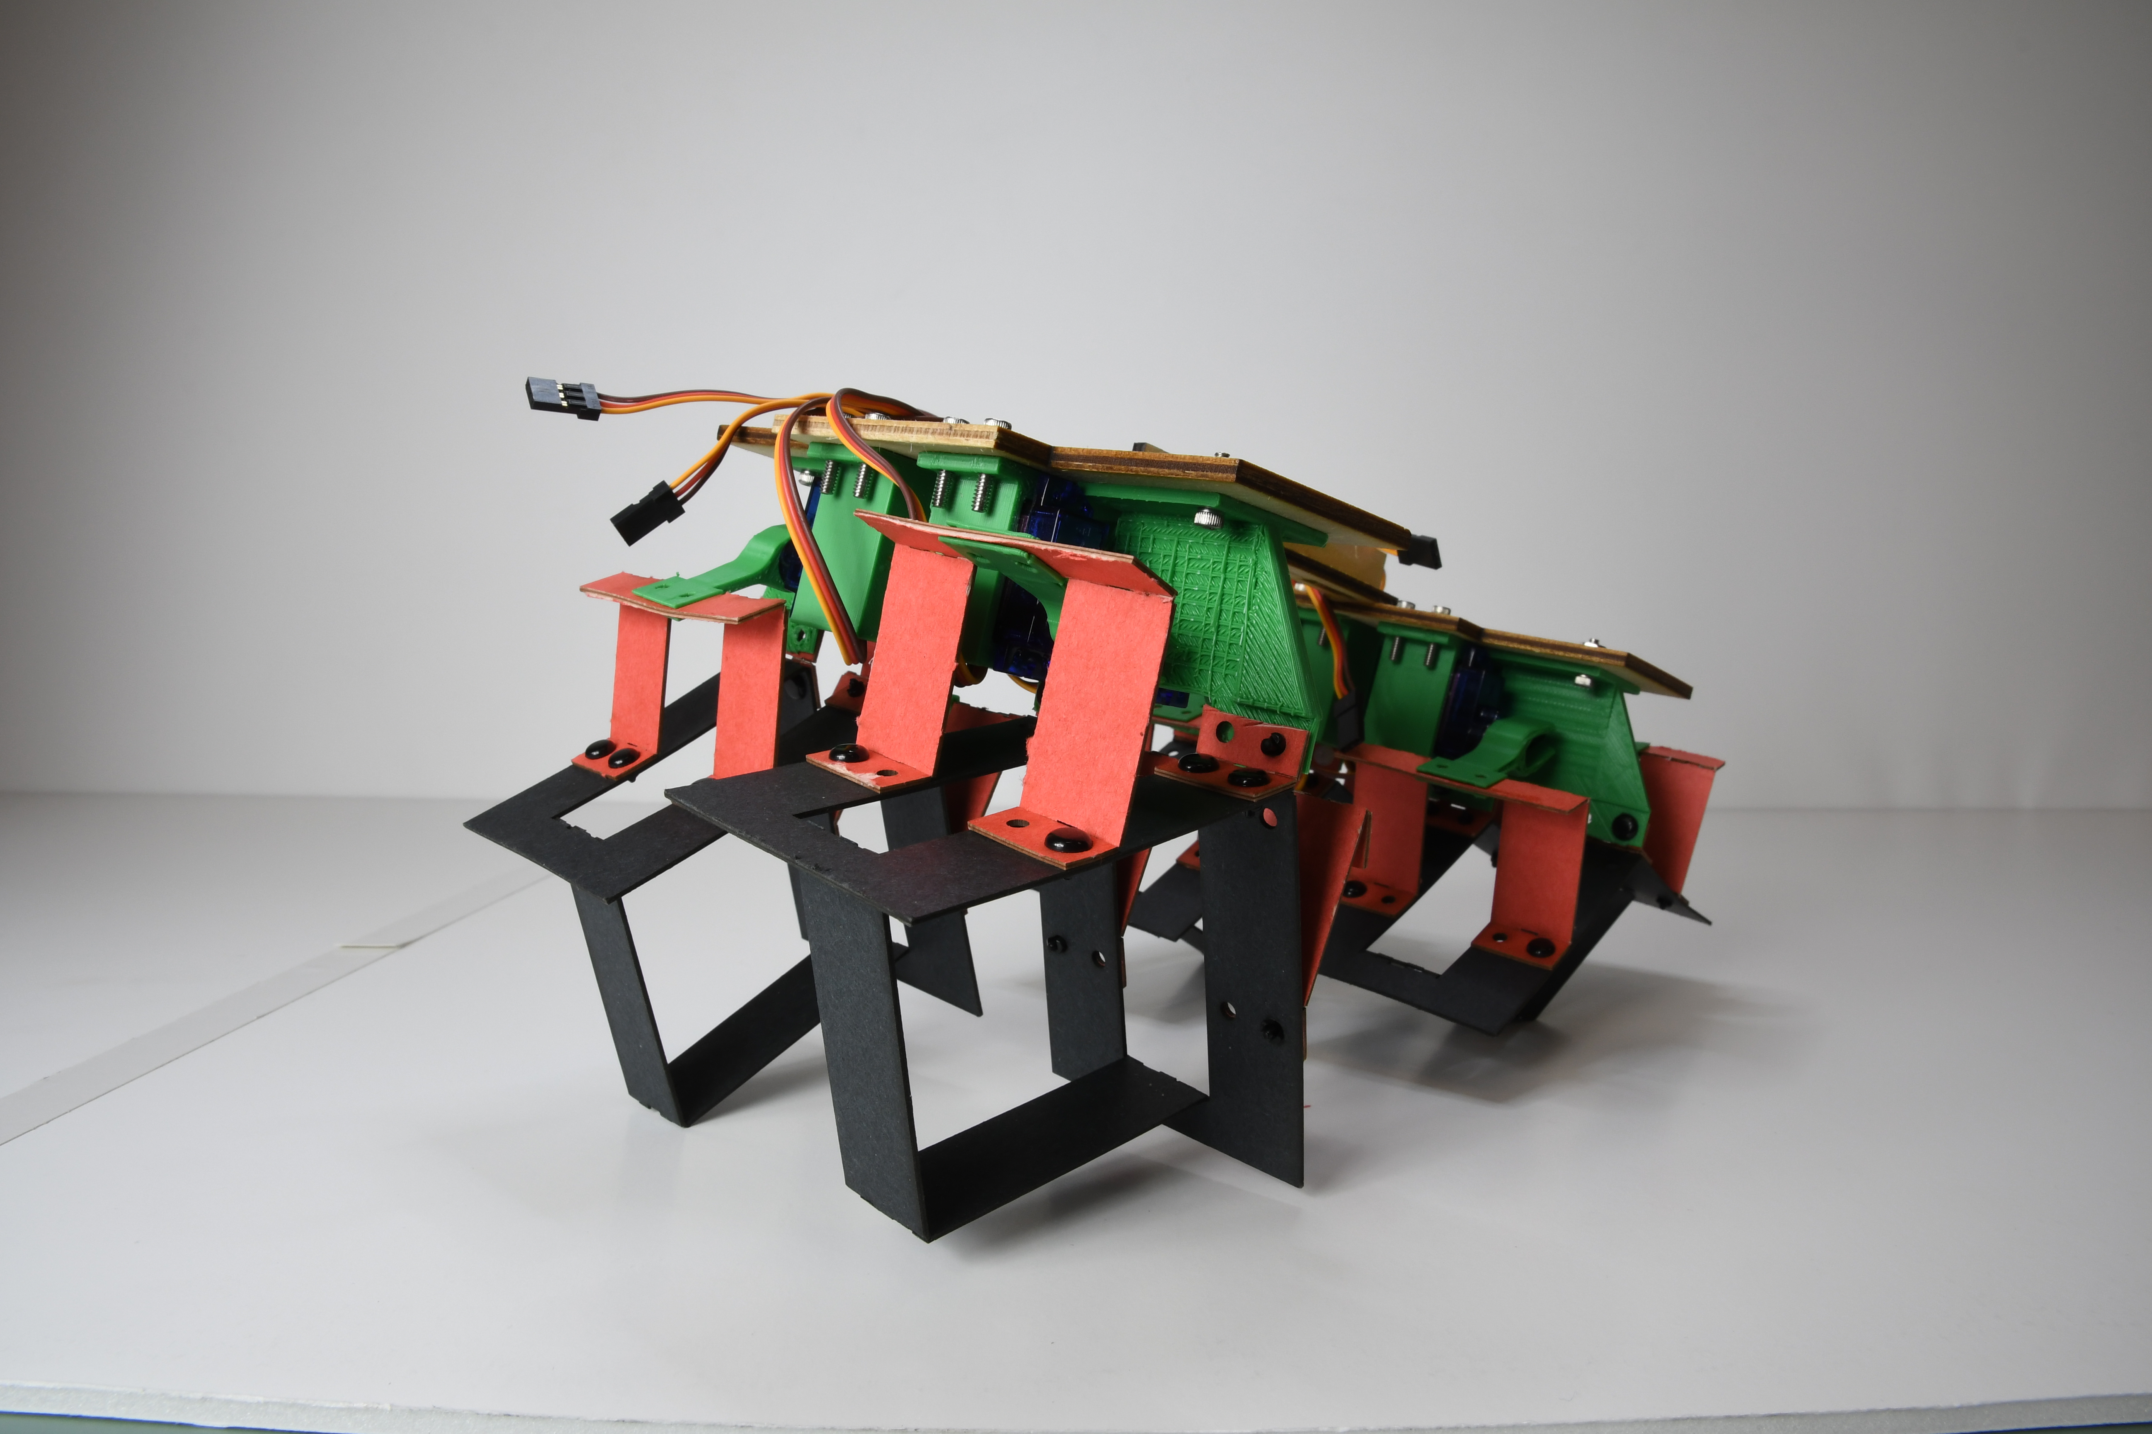
Laminate Robots
Flexible, easily printed materials used for robotics
Convenient for producing large quantities at low cost
Flexible nature could prove advantageous for certain applications

Slide 7
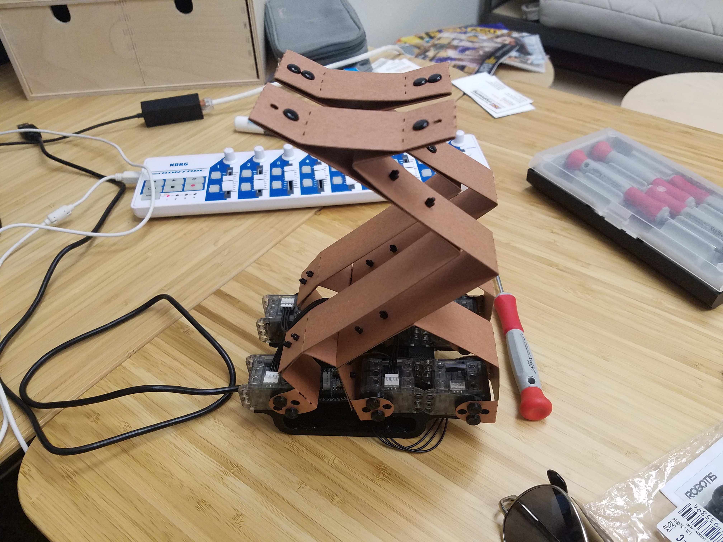
Objective
Develop bipedal laminate robot platform with 2DoF
Multiple design iterations developed a prototype capable of standing and movement

Slide 8
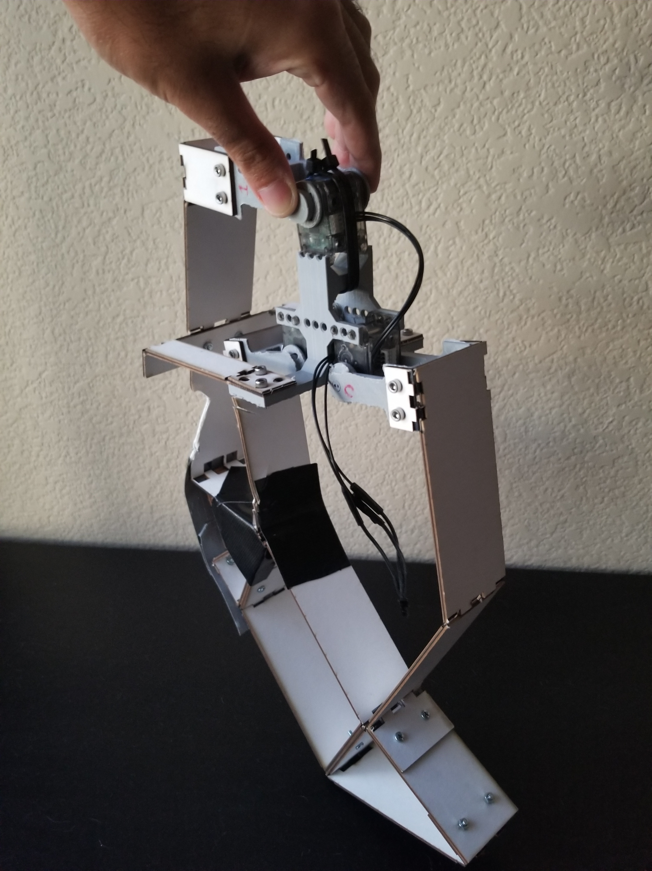
Current Design
Motors:
3 Dynamixel XL-320 Motors
Board:
OpenCM9.04
Laminate Material:
Cardboard
1.04 mm thick

Slide 9
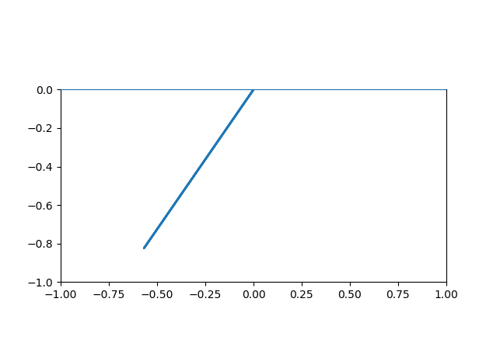
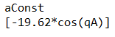
Modeling
Pynamics Simulations
Kane’s method
Hand Calculations
Lagrange
Rigid Body Dynamics
Hand Calculations
Pynamics
Soft Body Dynamics
Pynamics

Slide 10
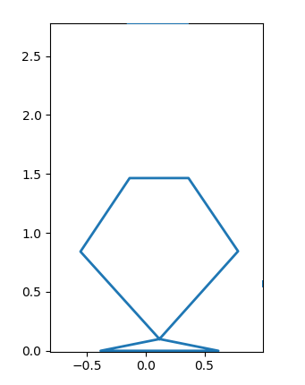
Model illustration

Slide 11
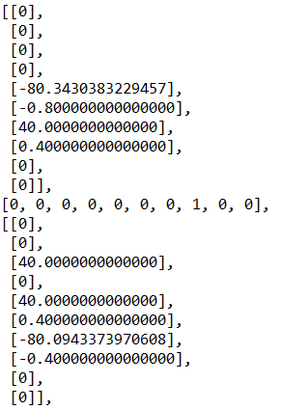
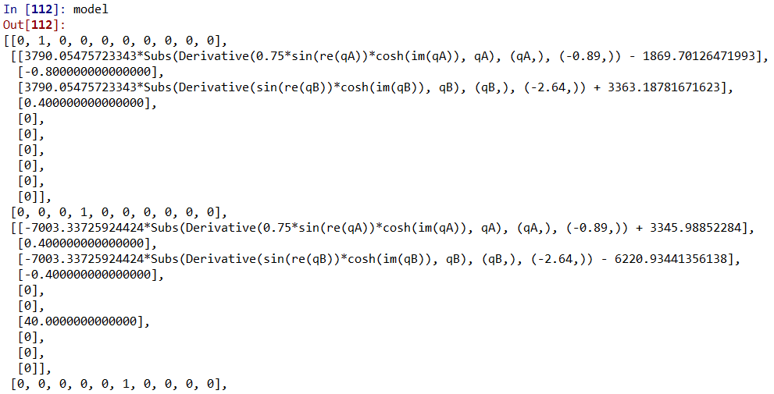
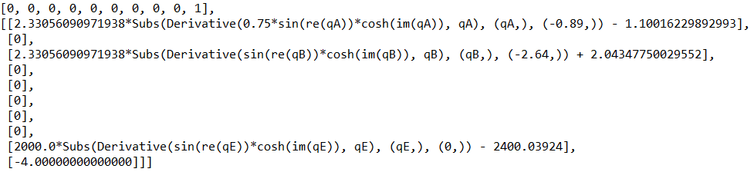
Pynamics Model

Slide 12
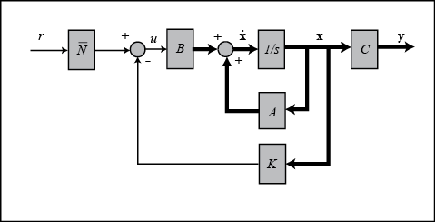
Controls Algorithms
LQR
Desirable sensitivity properties
Ideal for balancing
Optimal Control
Ideal for path following
Potentially useful for walking
Potentially need to switch between two different kinds of control systems between balancing and walking

Slide 13
Future Work
Adapt design to fit new motors
Implement model into LQR based controller and full state feedback controller
Adjust the model to account for flexible links
Measure the flexibility of links used in future design
Compare and contrast different control systems paired with different models to conclude the efficacy of model based control on laminate materials

Slide 14
Conclusion/Future Work
Optimization
Different Control Techniques
Laminate materials
Practical implementation of ideas in my thesis

